Slide 1
Web UI/UX
Week 02.

Slide 2
Objectives
Describe how fonts are set in web pages using CSS;
Describe how to set margins and paddings in web pages using CSS;
Demonstrate how to create responsive web design by using HTML and CSS.

Slide 3
Tools Required
Visual Studio Code
Browser
Google Chrome (recommended)
Mozilla Firefox

Slide 4
CSS: Working with fonts

Slide 5
Types of Fonts
System Fonts
Pre-installed fonts found in many Operating Systems.
Web Fonts
Non-system fonts that can be downloaded from the web.
Use by browsers by default.

Slide 6
System Fonts
Serif
Times
Times New Roman
Georgia
Sans-serif
Arial
Monospace
Courier
Cursive
Comic Sans
Helvetica
Verdana
Geneva
Courier New
Monaco

Slide 7
Requesting System Fonts
h1 {
font-family: Arial, Helvetica, Verdana, sans-serif;
}
First choice.
Second choice.
Third choice.
Fourth choice.

Slide 8
Web Fonts
Web fonts refer to the technique of having browser download and install fonts requested in the page’s styles, using the @font-face syntax.

Slide 9
Requesting Web Fonts
Font name.
@font-face {
font-family: ’DeliciousRoman’;
src: url(’http://www.fontface.com/fonts/delicious/Delicious-Roman.otf’);
font-weight: 400;
}
Font path/URL.
h1 {
font-family: DeliciousRoman, Helvetica, Verdana, sans-serif;
}

Slide 10
CSS Font Families
Generic Family | Font Family | Description
Serif | Times New Roman Georgia | Serif fonts have small lines at the ends on some characters
Sans-serif | Arial Verdana | "Sans" means without - these fonts do not have the lines at the ends of characters
Monospace | Courier New Lucida Console | All monospace characters have the same width

Slide 11

Font Family
Notes:
p {
font-family: "Times New Roman", Times, serif;
}

Slide 12
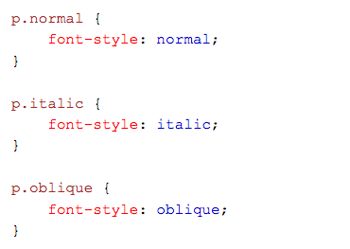
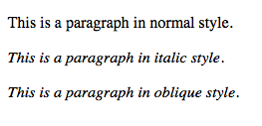
Font Style
Source
Output
oblique is less supported.
Notes:
p.normal {
font-style: normal;
}
p.italic {
font-style: italic;
}
p.oblique {
Font-style: oblique;
}

Slide 13
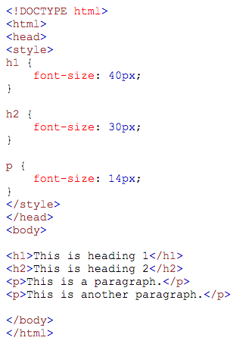
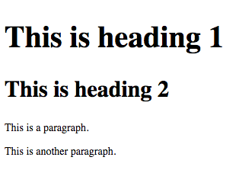
Font Size with Pixels
Source
Output
Notes:
<style>
h1 {
font-size: 40px;
}
h2 {
font-size: 30px;
}
p {
Font-size: 14px;
}
</style>

Slide 14
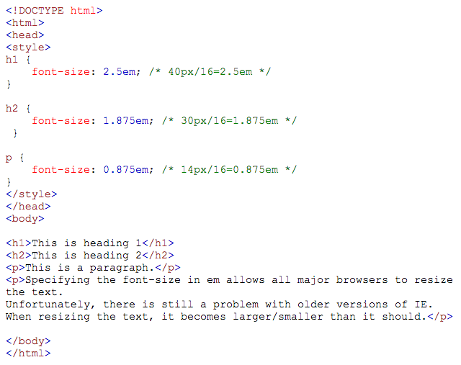
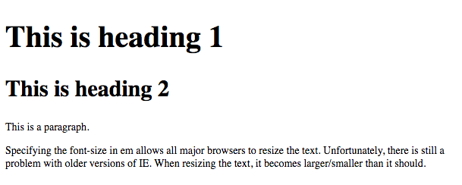
Font Size with Em
Assuming browser default font size is set to 16.
Source
Output
Notes:
<style>
h1 {
font-size: 2.5em;
}
h2 {
font-size: 1.875em;
}
p {
font-size: 0.875em;
}
</style>

Slide 15
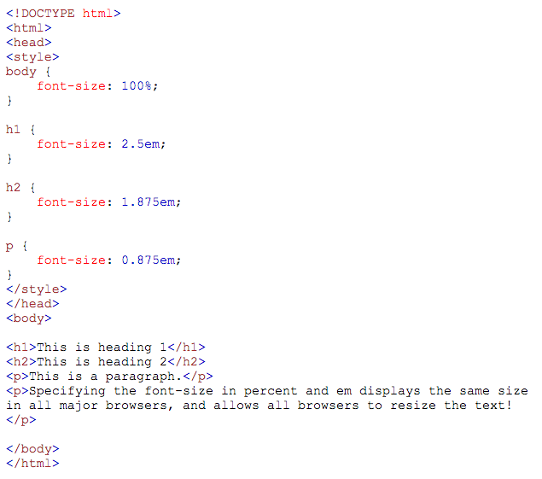
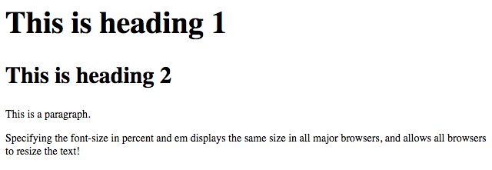
Font Size with Percent and Em
Source
Output

Slide 16
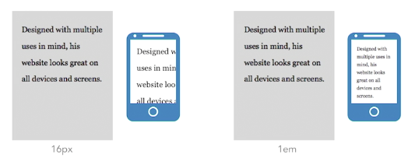
Fixed Units vs. Relative Units
Fixed units are displayed at the requested size, regardless of device or context.
E.g. px
Relative units are displayed relative to the environment in which they are found.
E.g. em

Slide 17
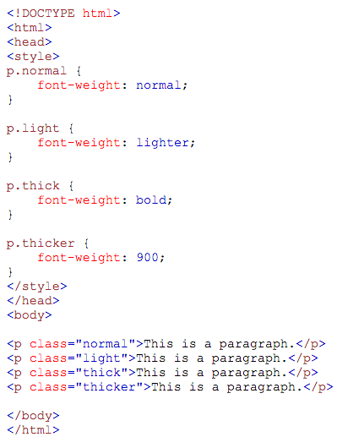
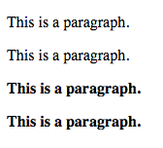
Font-Weight
Source
Output

Slide 18
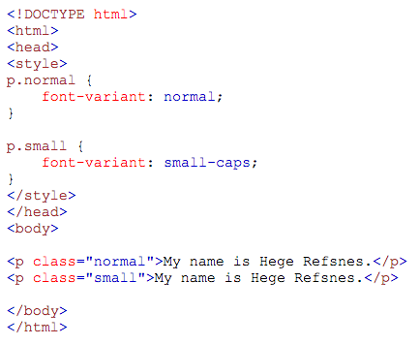

Font-Variant
Source
Output

Slide 19
Text Formatting
To learn more about CSS font and text formatting, check out the link below:
http://www.w3schools.com/css/css_text.asp

Slide 20
Css: Margins and Padding

Slide 21
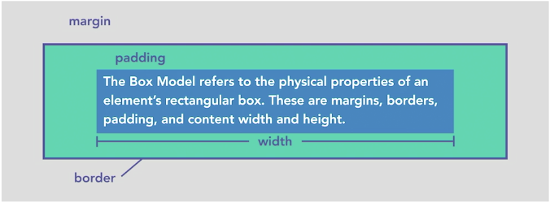
The Box Model

Slide 22
Margins
The CSS margin properties are used to generate space around elements.
The margin properties set the size of the white space OUTSIDE the border.
The margins are completely transparent - and cannot have a background color!

Slide 23
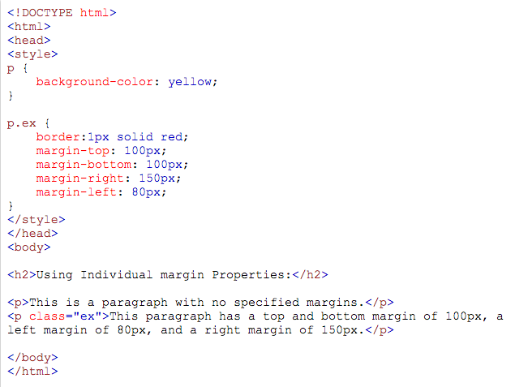
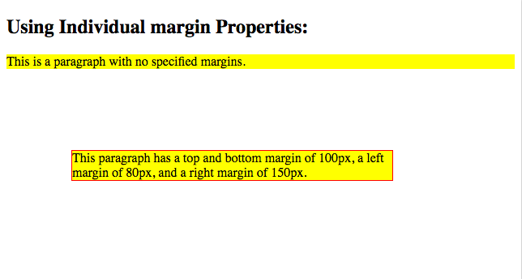
Margins: Individual Properties
Source
Output

Slide 24
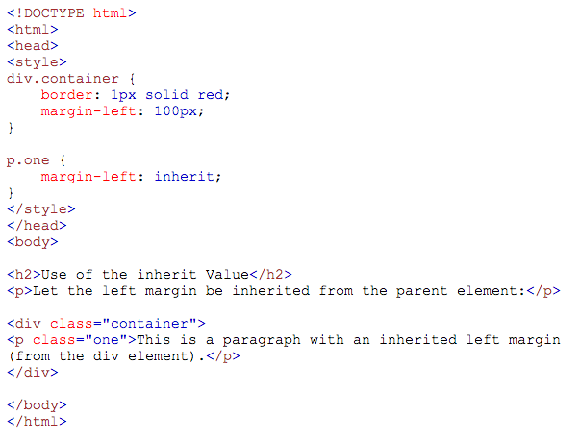
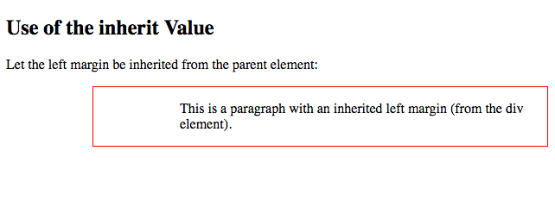
Margins: Inherit
Source
Output

Slide 25
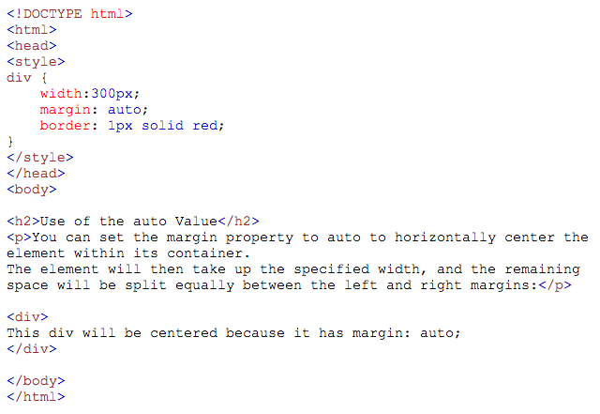
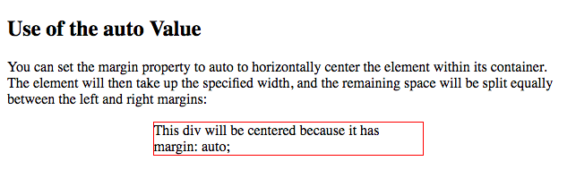
Margins: Auto
Source
Output

Slide 26
Padding
The CSS padding properties are used to generate space around content.
The padding properties set the size of the white space between the element content and the element border.
The padding is affected by the background color of the element!

Slide 27
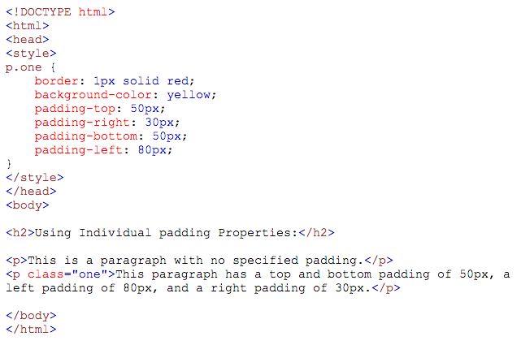
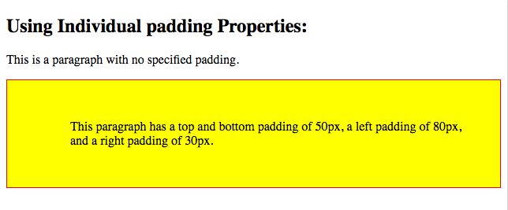
Padding: Individual Sides
Source
Output

Slide 28
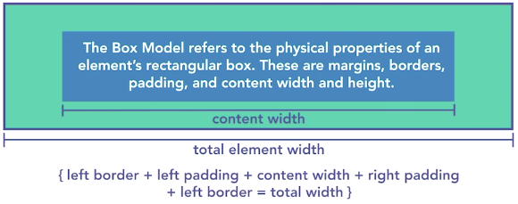
Width and Height

Slide 29
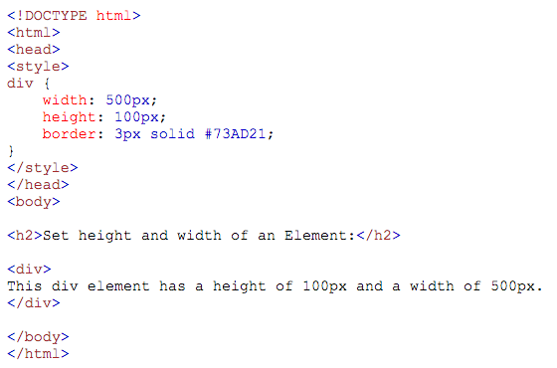
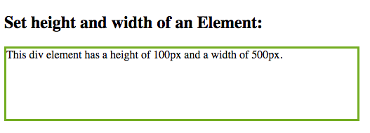
Setting Height and Width
Source
Output

Slide 30
Basic css layout concepts

Slide 31
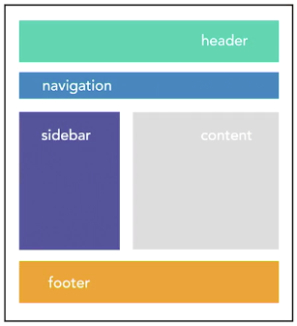
Content Regions

Slide 32
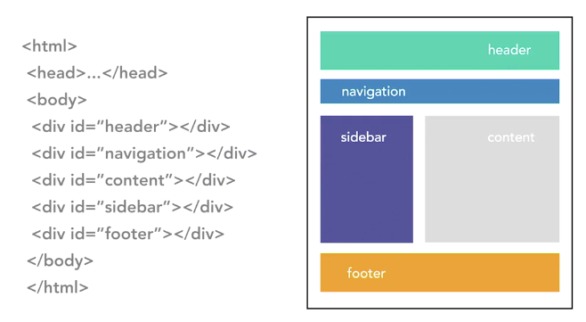
Content Regions: Before HTML5

Slide 33
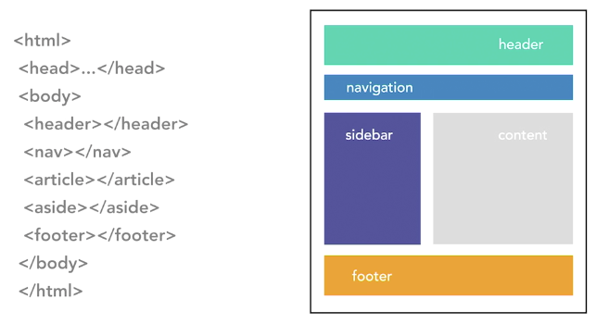
Content Regions: Using HTML5

Slide 34

Creating Initial Page Elements

Slide 35
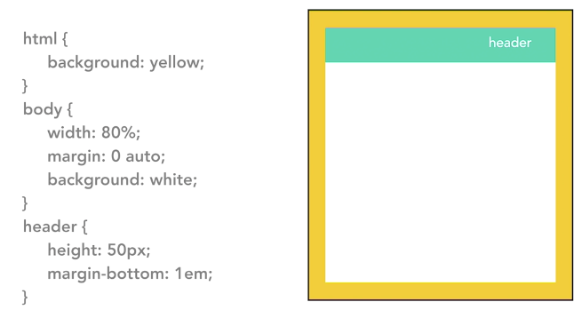
Adding Header

Slide 36
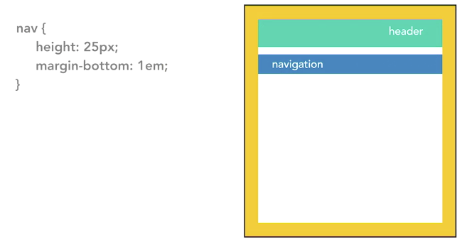
Adding Navigation

Slide 37
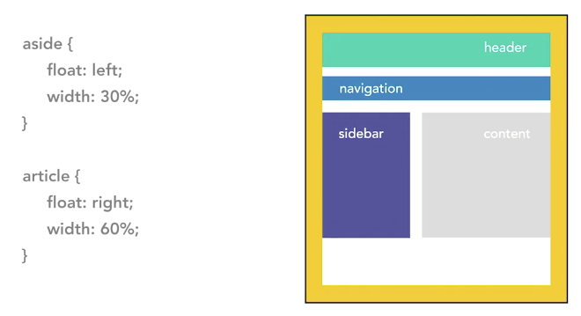
Adding Sidebar and Content

Slide 38
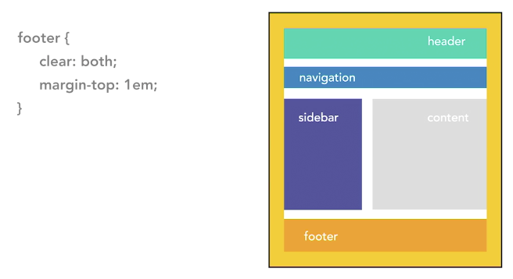
Adding Footer

Slide 39

Example

Slide 40
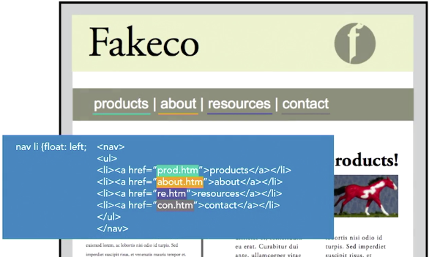
Example: Navigation

Slide 41
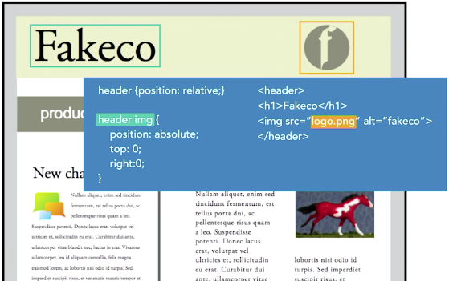
Example: Header Images

Slide 42
The End

